Slide 1


SBR Overview
FLEXIBLE. EXPERIENCED. RESULTS ORIENTED.
Notes:
1
1

Slide 2
Table of Contents
1
Who We Are
2
What We Do
3
Why We Do It
4
Contact Information
Notes:
How should we title the sections to best convey:
1. Who we are? – About Strategic Benefit Resources
2. What we do? – Solutions and Services
3. Why we do it? – Value proposition to Brokers/Consultants, Third Party Administrators and Carriers
Should we include the state of the market section?

Slide 3
Who We Are

Slide 4
About Strategic Benefit Resources
Flexible. Experienced. Results Oriented.
Strategic Benefit Resources partners with employee benefit advisors, third party administrators and other intermediaries to provide specialized self-funded health plan expertise, customized outsourced stop-loss insurance services, and unique technology-driven solutions.
This is all achieved through strong stop-loss carrier and vendor relationships, extensive industry expertise and proprietary risk analysis and decision support tools.
Stop-Loss Insurance Services
Self-Funded Health Plan Consulting Services
Technology and Data-Driven Solutions

Slide 5
WHAT WE DO

Slide 6



What We Do
STOP-LOSS INSURANCE SERVICES
SELF-FUNDED HEALTH PLAN CONSULTING SERVICES
TECHNOLOGY AND DATA-DRIVEN SOLUTIONS
Strategic Benefit Resources works with you to maximize the value you bring to your clients. We take ownership of the stop-loss insurance process from start to finish, enhance your offerings and streamline your workflow by providing comprehensive stop-loss insurances services.
Whether its helping manage the components of a self-funded health plan or structuring complex group purchasing deals, SBR can be your back-office self-funded health plan expert. Regardless of your needs, the Strategic Benefit Resources team has the expertise to help add value to your business.
Our data-driven solutions, combine comprehensive analytics with innovative technologies and expert data management to enable our employee benefit broker partners and their clients to better manage their self-funded health plans.

Slide 7
STOP-LOSS INSURANCE SERVICES

Slide 8
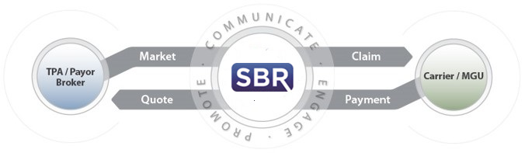
Stop-Loss Insurance
Services
Stop-Loss Marketing and Risk Decision Support Analytics
We understand the complexity of medical stop-loss insurance, the underlying contract details and why they are important. Negotiations are not specific to rate alone. We work with industry leading carriers to analyze their contracts, understand their value added services and ensure we’re delivering the best available benefits package to you and your clients.
Policy Disclosure and Implementation Management
Transactional
Consultative
Web-Based Intake (HIPAA Compliant)
Renewal/New Case Submission Review
Prepare Request for Stop-Loss Proposal Market Submission
Negotiate Pricing, Terms and Conditions
Stop-Loss Marketing Report
Analyze and Optimize Stop-Loss Market Results – SL Advisor 3.0
Plan Design Optimization
Analyze Case Specific Health Risk
Insured to Self-Funded Plan Analysis
Provider Network Evaluation
Reference Based Pricing Analysis
PBM Analysis
Cost Containment Program Evaluation and Strategies
Financial Underwriting and Premium Equivalent Rate Development
Stop-Loss Claims Management

Slide 9
Stop-Loss Insurance
Services
Stop-Loss Marketing and Risk Decision Support Analytics
Strategic Benefit Resources takes ownership of the benefit placement process, including disclosure management for Medical Stop-Loss. Prior to final contract approval, we provide a thorough contract review to ensure all negotiated contract features, rates and rate guarantees are included.
Collect all required new business applications and documents.
Manage the disclosure process and negotiate any potential lasers.
Review contracts to confirm all negotiated rates and benefits are accurate.
Manage regulatory requirements of health care reform.
Minimize mistakes, contract gaps and potential future claim liability.
Policy Disclosure and Implementation Management
Stop-Loss Claims Management

Slide 10
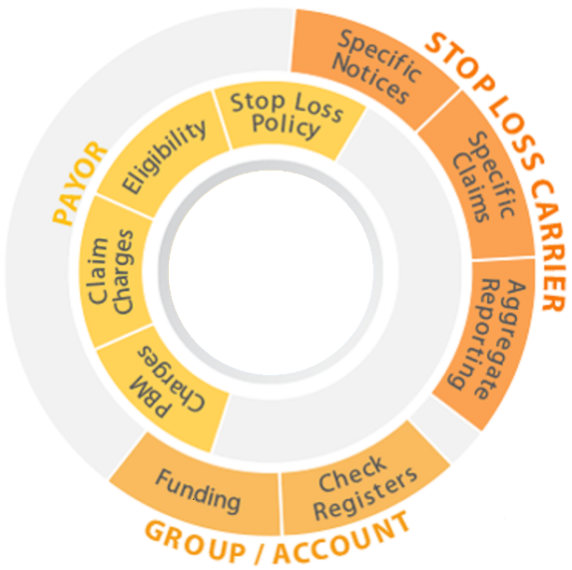

Stop-Loss Insurance
Services
Stop-Loss Marketing and Risk Decision Support Analytics
Strategic Benefit Resources aggressively manages all stop-loss claims to ensure claims are adjudicated accurately and reimbursed expeditiously.
Claims Processing and Management
Submit Specific 50% and trigger diagnosis notifications, claims, and appeals directly to the carrier or MGU.
Import and submit line-by-line claim details.
Attach and submit documentation for eligibility, pre-certification, case management, subrogation, COBRA, etc. to completely document the claim.
Automated web-based eligibility verification process.
Track aged claim receivables by policyholder, claimant and carrier.
Record claim recoveries by date received and all charges pended or denied by the carrier.
File appeals for pended and denied charges and track all outstanding pended or denied charges by policyholder, claimant and carrier until complete.
Policy Disclosure and Implementation Management
Stop-Loss Claims Management

Slide 11
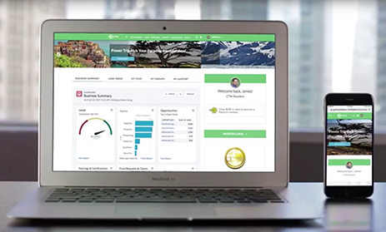
Broker Portal
Aggregation, Access and Transparency
Stop-Loss Marketing
Automated marketing submission intake
Real-time access to stop-loss marketing activity
Aggregated market statistics reporting by book of business
Customized User Access
Security
HIPAA Compliant
Self-Funding Knowledge Center
Knowledge Database
White Papers
Educational Content
Powerpoint Presentation Templates
Stop-Loss Policy Management
Real-time access to stop-loss policy details
Access to policy documentation (i.e. policy, riders/endorsements)
Access to sold case documentation (i.e. disclosure statements, carrier proposal)
Stop-Loss Claims Management
Real-time access to stop-loss claims information (i.e. claimant, policyholder, carrier, book of business)
Aggregated claims reporting by book of business
Revenue Tracking
Internal Collaboration

Slide 12
SELF-FUNDED HEALTH PLAN CONSULTING SERVICES

Slide 13

Self-Funded Health Plan Consulting
Flexible. Experienced. Results Oriented.
Strategic Benefit Resources can be your back-office self-funded health plan expert. We can manage the entire process or just pieces of the process. Whether it is managing the self-funded health plan vendor selection process (i.e. TPA, pharmacy benefit manager, provider network, wellness/disease management vendor), plan design consulting services or actuarial and underwriting support, the Strategic Benefit Resources team has the expertise to help you.
Alternative Risk Transfer Strategies
Third Party Administrator Evaluation, Selection and Implementation
Provider Network Evaluation, Selection and Implementation
Plan Design Consulting
Financial Underwriting and Premium Equivalent Rate Development including employer/employee cost sharing strategies
Financial Reporting and Claims Modeling
Plan document review and compliance
Notes:
Does this convey what we do?
Do we need to add, delete or modify?
Should we have separate slides that further expand each of the services, similar to what we did with the stop-loss insurance management slides?

Slide 14

Alternative Risk Transfer Solutions
Flexible. Experienced. Results Oriented.
For some clients, they are looking for cutting edge, risk transfer strategies. Strategic Benefit Resources has the expertise to assist you and your clients in the evaluation, selection, implementation and management of these strategies.
Group Purchasing Coalitions
Risk Retention Groups
Captives
Loss Financing Programs
Performance Based Participation Programs
Notes:
Does this convey what we do?
Do we need to add, delete or modify?
I pulled some of these alternative strategies from other sources. Review and let me know what you think. I’m familiar with the group purchasing coalitions, risk retention groups and captives. I’m not sure about quota share programs and I think I know what performance based participation programs are. Since many of these programs are similar, should we just condense it to Group Purchasing Coalitions and Captives and further explain each of these programs?
Should we add “Shared Loss Financing Program”, similar to what the VHA is doing with their hospital members? We could create a similar program for other homogeneous associations.
I think could be another differentiator for us.

Slide 15
TECHNOLOGY AND DATA-DRIVEN SOLUTIONS
TRANSFORMING DATA INTO RESULTS

Slide 16
Solutions for the Self-Funded Health Plan Ecosystem
Pricing Transparency
Wellness
Chronic Condition Management
Vendor Performance Management
Stop-Loss Insurance
Self-Funded Health Plan
Large Case Management
Third Party Claims Administration
Pharmacy Benefit Management (PBM)

Slide 17
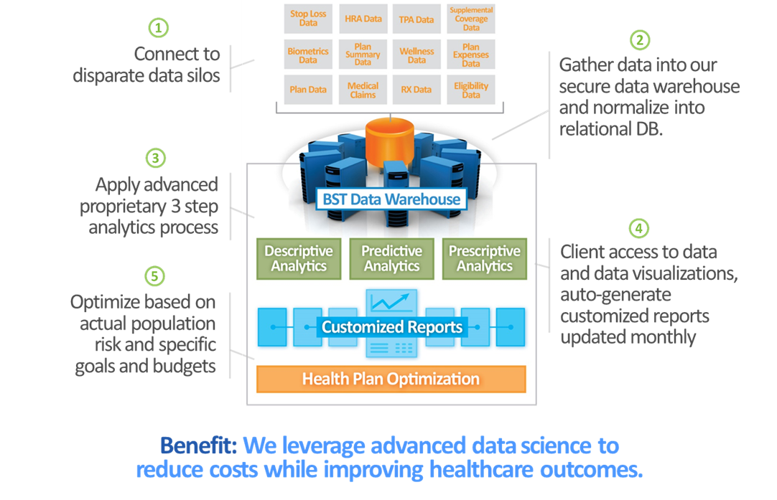
TRANSFORMING SELF-FUNDED HEALTH PLAN MANAGEMENT
Turning Data into Actionable Solutions and Results
Data is everywhere. Effectively managed, data can be transformed into better decisions, greater efficiency, improved quality and better integration.
At Strategic Benefit Resources, we believe data is the key to effectively managing a self-funded health plan. Whether it is identifying, stratifying and managing a population’s health risk or improving the renewal and marketing processes, Strategic Benefit Resources is committed to assisting our employee benefit broker partners to better manage their client’s data.
Our data-driven solutions, combine comprehensive analytics with innovative technologies to enable our employee benefit broker partners and their clients to better manage their self-funded health plans. Our solutions focuses on four main areas:
Automation
Audit
Analysis and Optimization
Integration

Slide 18
CONTACT INFORMATION

Slide 19

Contact Information
Strategic Benefit Resources
2839 Paces Ferry Road SE
Suite 830
Atlanta, GA 30339
http://www.strategicbenefitresources.com
info@strategicbenefitresources.com
(470) 344-1001

